Slide 1
Student Grading System: A Comprehensive Java-Based Application
The Student Grading System is a Java-based application designed to simplify and automate the process of managing and evaluating student academic performance. This system utilizes Java for both front-end and back-end development, with MySQL serving as the database management system. By integrating these technologies through XAMPP, the project provides a reliable and interactive platform for recording student names and grades across multiple subjects, calculating average grades, and assigning final grades based on a predefined grading scale.

Slide 2
Introduction
In academic institutions, managing student grades and evaluating their performance is a critical yet time-consuming task. Manual processes for recording grades, calculating averages, and assigning final results are prone to errors, inefficiencies, and inconsistencies.
To address these challenges, the Student Grading System is developed as an efficient and automated solution for handling student performance data. This system is a standalone application built entirely using Java for both the front-end and back-end, with MySQL serving as the database for secure and structured data storage.

Slide 3
Objectives
1
Automate Grade Management
2
Simplify Data Entry and Retrieval
3
Dynamic Grade Calculation
Provide a digital platform to calculate, store, and retrieve student grades accurately and efficiently.
Enable users to input and manage student grades seamlessly through an interactive graphical user interface.
Automatically calculate final grades based on user-provided marks and predefined grading scales.
4
Visual Grade Representation
Display grades in an organized table format with visually appealing highlights for better clarity.

Slide 4
Modules
Grade Management Module
Display Module
Database Module
This module allows teachers to input student names and marks for multiple subjects, calculate final grades, and manage student records.
This module provides students and teachers with access to view grades in an organized table format, including subject-wise grades and final grades.
This module handles secure storage and retrieval of student records, marks, and grades in a MySQL database.
Student Records
Login & Dashboard
View Grades
Data Retrieval
Grade Entry
Detailed Record View
Final Grade Calculation
Back Navigation
Record Management
Student Records

Slide 5
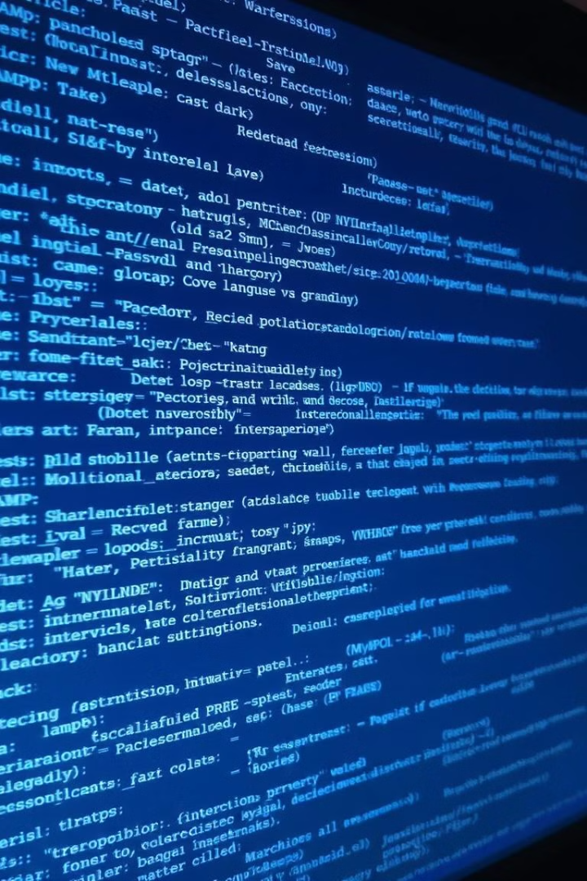
Software Description
Java
MySQL
Java is a versatile, object-oriented programming language used for both the backend logic and the graphical user interface (GUI). It provides tools to create an intuitive and visually appealing interface, enabling efficient interaction between users and the system.
MySQL is an open-source Relational Database Management System (RDBMS) used to store student details, subject-wise marks, and corresponding grades in a structured manner.
XAMPP
XAMPP is an open-source, cross-platform server solution used to host and manage the MySQL database locally, providing a convenient interface to configure and test database operations.

Slide 6
Hardware and Software Requirements
Operating System
Windows 10 or higher
Programming Language
Java (JDK 8 or higher)
Frontend
Java Swing for the graphical user interface
Backend
MySQL for database operations
Database Management System (DBMS)
MySQL 8.0 or higher, hosted locally using XAMPP
Development Tools
Text Editor: Notepad for writing source code, Command Line: CMD for compiling and running the application
Libraries/Packages
Java JDBC for database connectivity

Slide 7
Data Dictionary
The database table "students" stores student details, including their individual subject marks and overall grade.
Column Name
Data Type
Description
ID
INT AUTO_INCREMENT
Unique identifier for each student (Primary Key).
Name
VARCHAR(50)
Full name of the student.
Subject1
FLOAT
Marks obtained by the student in Subject 1.
Subject2
FLOAT
Marks obtained by the student in Subject 2.
Subject3
FLOAT
Marks obtained by the student in Subject 3.
Subject4
FLOAT
Marks obtained by the student in Subject 4.
Subject5
FLOAT
Marks obtained by the student in Subject 5.
Grade
VARCHAR(5)
The final grade (e.g., A, B, C, etc.) based on average marks.

Slide 8

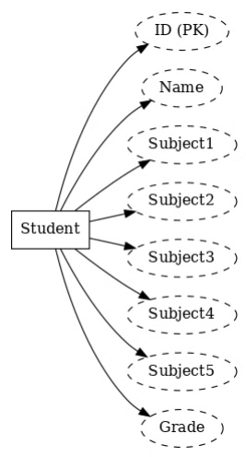
ER Diagram
The ER diagram illustrates the relationships between the entities in the database, including students, subjects, and grades. This diagram helps visualize the data structure and relationships within the Student Grading System.

Slide 9

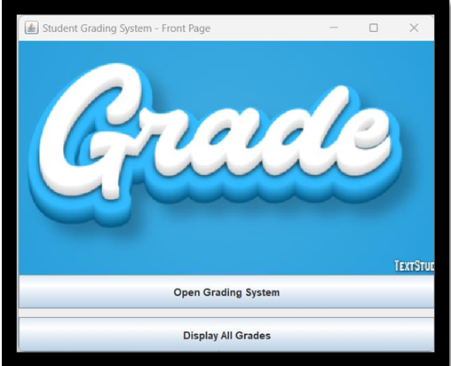
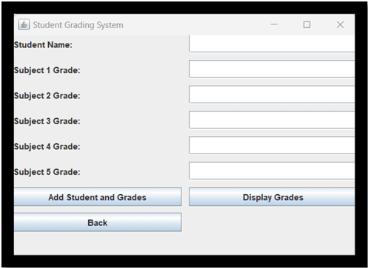

Results and Discussion
The Student Grading System successfully implements a functional backend and frontend for managing student grades. Key features include dynamic grade calculation, user authentication, and seamless database interaction. The project delivers a user-friendly interface and real-time data updates but can be enhanced further by incorporating advanced security measures, improved validation, and report generation features.

